Slide 1
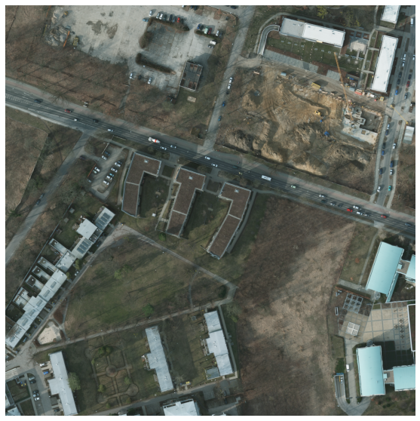
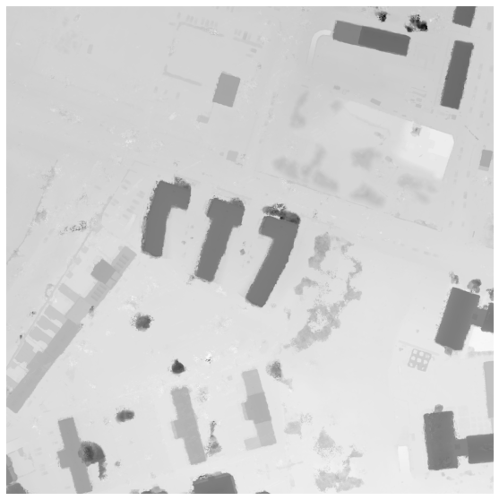


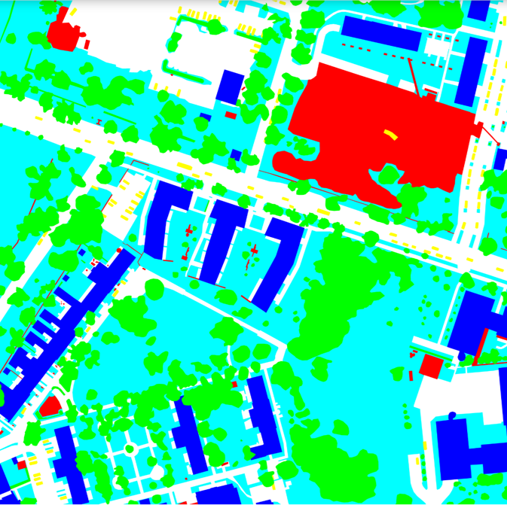
3×512×512
1×512×512
RGB
DSM
ConvNext
Conv2D_1_R
Channel
Embedding
RGB and DSM
Feature Map
HW×1
C/r×1×1
Rn
Dn
128×128×128
256×64×64
512×32×32
1024×16×16
Softmax
LayerNorm
GELU
Residual
Global Average Pooling
R1
D1
HW×1
C/r×1×1
GAP
R1
D1
R1
D1
R1
D1
ADAPTIVE
AVGPOOL2D
1D Convolution
(kernel size=k)
DSM: C×H×W
C×1×1
Transform
C/r×r×HW
Conv1D_k
CREM
CREM
CREM
CREM
CREM
CREM
CREM
CREM
Context Modeling
128×128×128
128×128×128
256×64×64
256×64×64
512×32×32
512×32×32
1024×16×16
1024×16×16
C/r×r×HW
Conv2D_1 _R
2D Convolution
With Reshape operation
MRFM
MRFM
MRFM
MRFM
Conv2D_1_R
Softmax
C/r×r×r
Conv2D_1 _R
C/r×HW×r
Decoder
RGB: C×H×W
C×H×W
(c) Multimodal Representation Fusion Module (MRFM)

Slide 2

(C,H,W)
Local Branch
Residual
3×512×512
1×512×512
C×H×W
SCLA
DSM
3×3, d=6
BN
5×5
1×1
(C,H,W)
RGB
ConvNext
3×3, d=12
C
1×1
7×7, d=3
3×3
128×128×128
1024×16×16
Rn/Dn
3×3, d=18
Mish
1×1
(C,H,W)
Mish
(C,H,W)
256×64×64
512×32×32
DS-ASPP
(C*,H,W)
(C*,H,W)
1×1
1×1
R1
D1
R1
D1
R1
D1
R1
D1
GeM Pooling
Global Branch
(C,1,1)
CREM
CREM
CREM
CREM
CREM
CREM
CREM
CREM
128×128×128
256×64×64
512×32×32
（b）Contextual Representation Enhancement Module (CREM)
1024×16×16
CMFM
CMFM
CMFM
CMFM
(C, H,W)
256×64×64
512×32×32
Key Embedding
(C·N, H,W)
128×128×128
Decoder
1024×16×16
C×H×W
3×3
1×1
(2C,H,W)
BN
Reshape
Mean
Rn
Dn
RGB and DSM
Feature Map
RGB
BN
C
Mish
(C, H,W)
BN
BatchNorm layer
C×H×W
Relu
1×1
Softmax
DSM
Query
MLP
(C, H,W)
Mish
Relu
Activation Layer
3×3
(C, H,W)
3×3, d=18
Kernel size = 3,
Dilation rate = 18
BN
(C, H,W)
C
Concat
Value Embedding
γ
Matrix/ Element product
（a）Overview of the proposed framework
(c) Cross-Modal Fusion Module (CMFM)

Slide 3
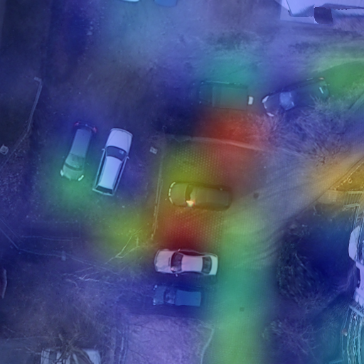
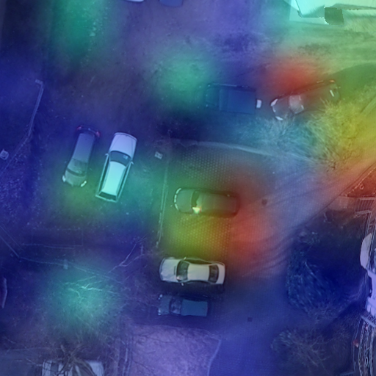
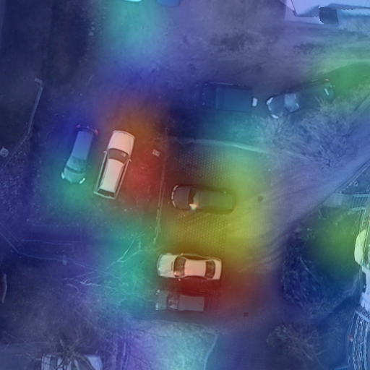
(a) + CREM (b) + CMFM (c) + CREM + CMFM

Slide 5
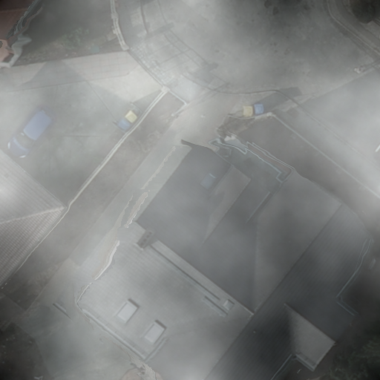
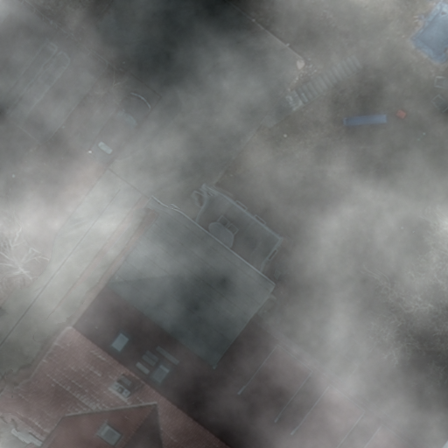
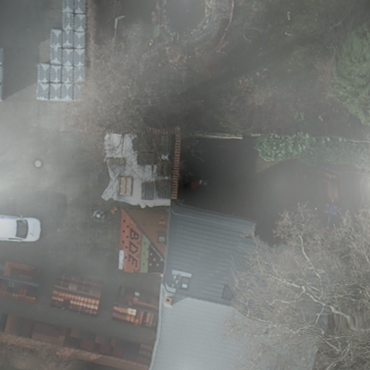
Surface
Car
Building
Car
（a) (b) (c)
Building
Tree
Car
Low Vegetation
Car or Clutter?
（d) (e) (f)

Slide 6
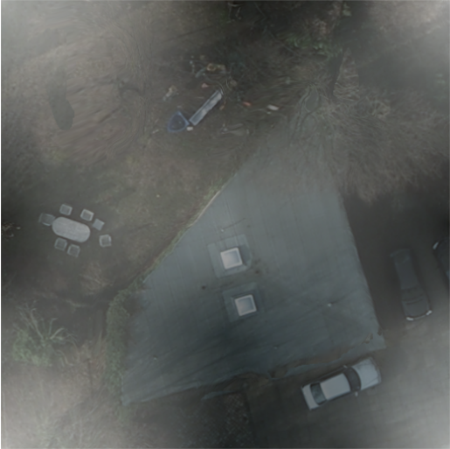
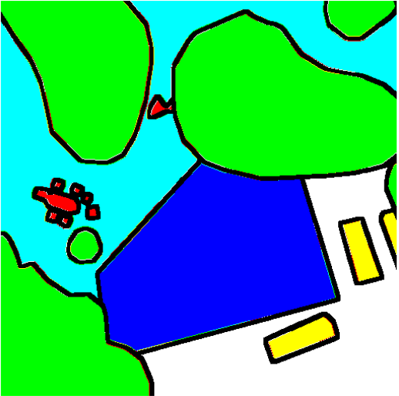
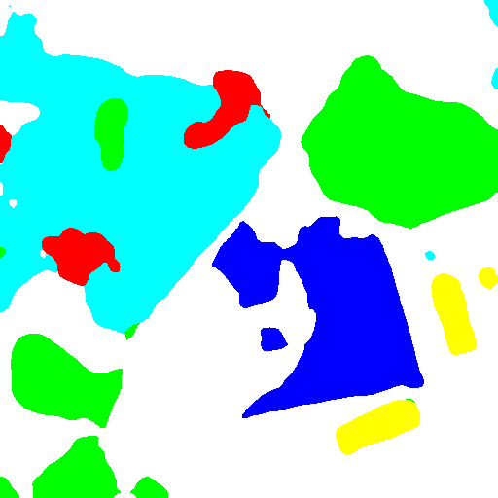
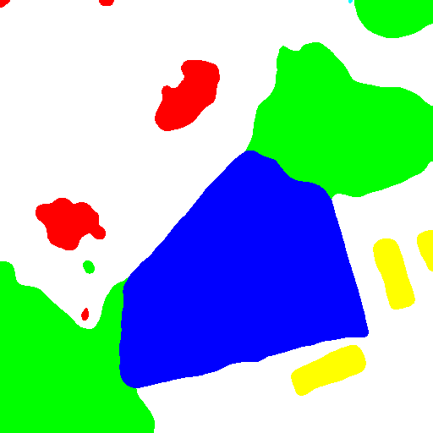
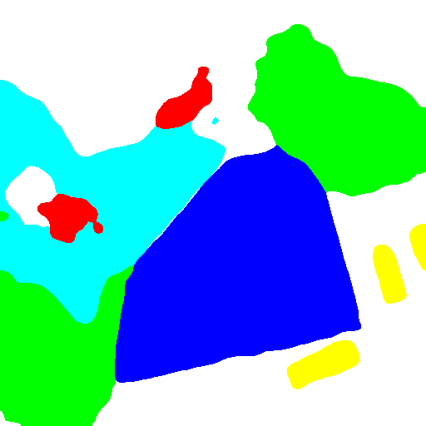
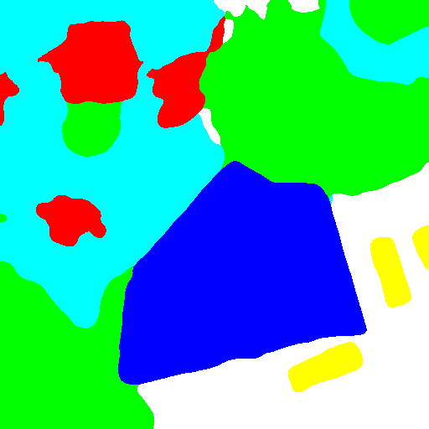
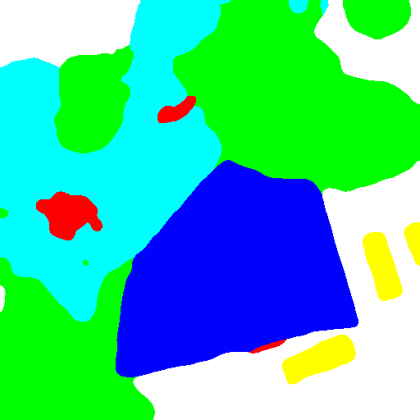
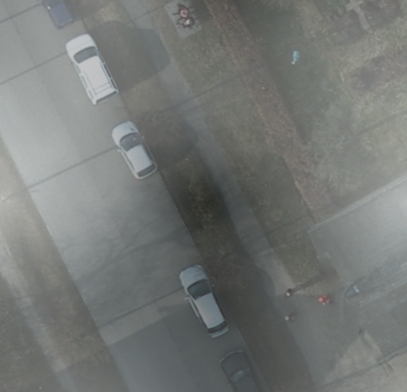
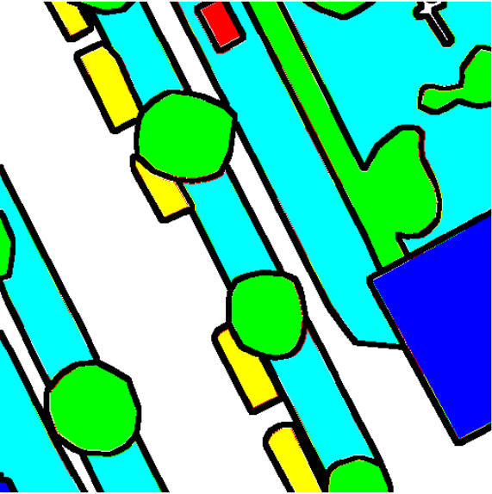
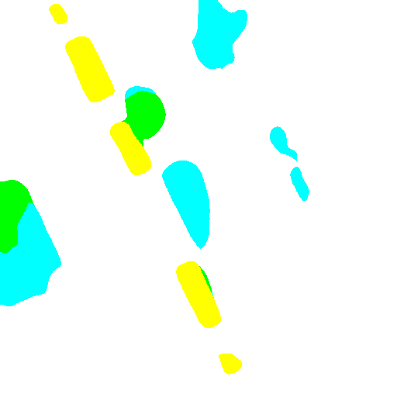
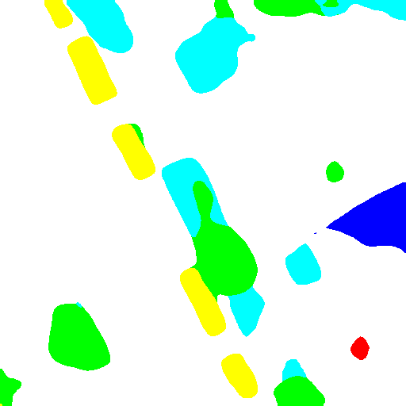
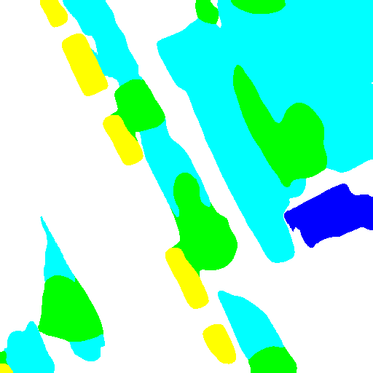
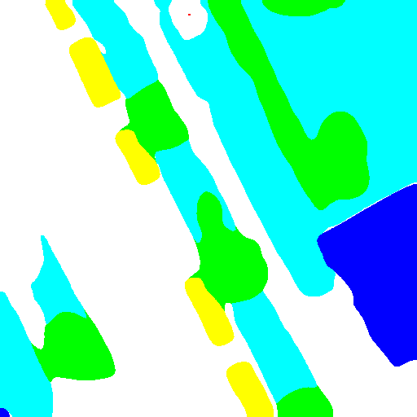

(a) Corrupted Raw Image (b) Ground Truth (c) DeepLabV3+ (d) TransUNet (e) Swin-Transformer (f) Ours on Clean (g) Ours on Fog
(a) Corrupted Raw Image (b) Ground Truth (c) DeepLabV3+ (d) TransUNet (e) Swin-Transformer (f) Ours on Clean (g) Ours on Fog

